Slide 1
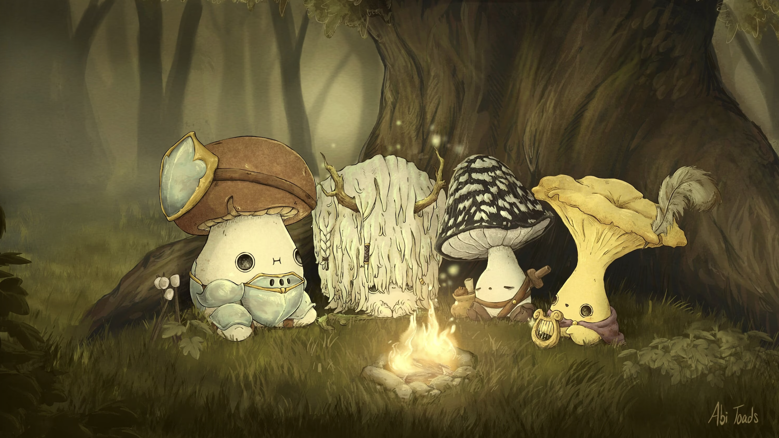
ML Mushroom Classification Project
By Louie, Augustine, Matthew, Bumsu

Slide 2

Table of Contents
Introduction
Data exploration
Dictionary
Methodology
Data Cleaning/Preparing
Random Forest
PCA
So what?
Q&A

Slide 3
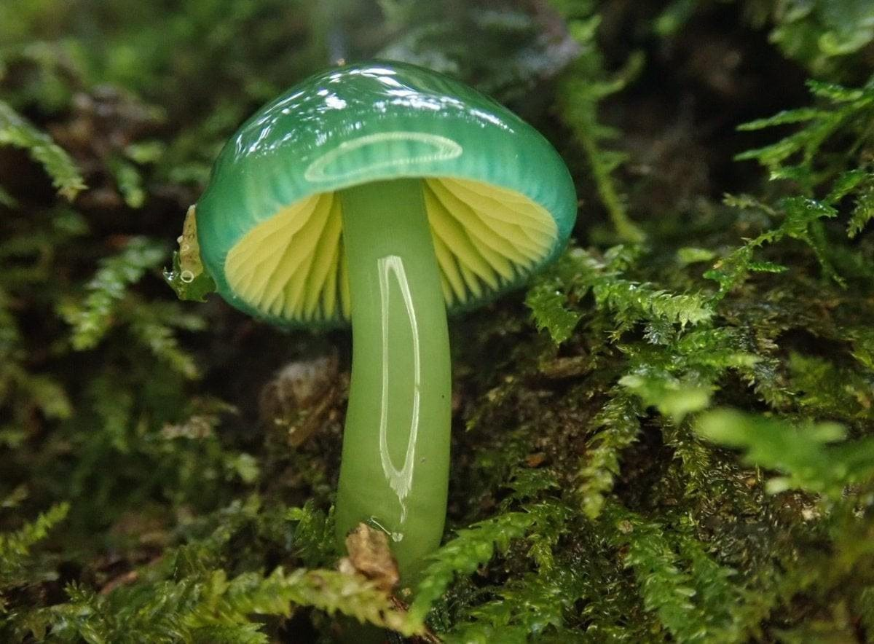
Introduction: Data Exploration
The Audubon Society Field Guide to North American Mushrooms (1981)
Contains phenotypical characteristics of 23 species of gilled mushrooms in the Agaricus & Lepiota Mushroom Families
Each species is identified as definitely edible, definitely poisonous, or of unknown edibility and not recommended
This latter class was combined with the poisonous one. The Guide clearly states that there is no simple rule for determining the edibility of a mushroom; no rule like "leaflets three, let it be'' for Poisonous Oak and Ivy.
“Learn which features spell certain death and which are most palatable in this dataset of mushroom characteristics”
Notes:
Context
Although this dataset was originally contributed to the UCI Machine Learning repository nearly 30 years ago, mushroom hunting (otherwise known as "shrooming") is enjoying new peaks in popularity. Learn which features spell certain death and which are most palatable in this dataset of mushroom characteristics. And how certain can your model be?
Content
This dataset includes descriptions of hypothetical samples corresponding to 23 species of gilled mushrooms in the Agaricus and Lepiota Family Mushroom drawn from The Audubon Society Field Guide to North American Mushrooms (1981). Each species is identified as definitely edible, definitely poisonous, or of unknown edibility and not recommended. This latter class was combined with the poisonous one. The Guide clearly states that there is no simple rule for determining the edibility of a mushroom; no rule like "leaflets three, let it be'' for Poisonous Oak and Ivy.
Time period: Donated to UCI ML 27 April 1987

Slide 4
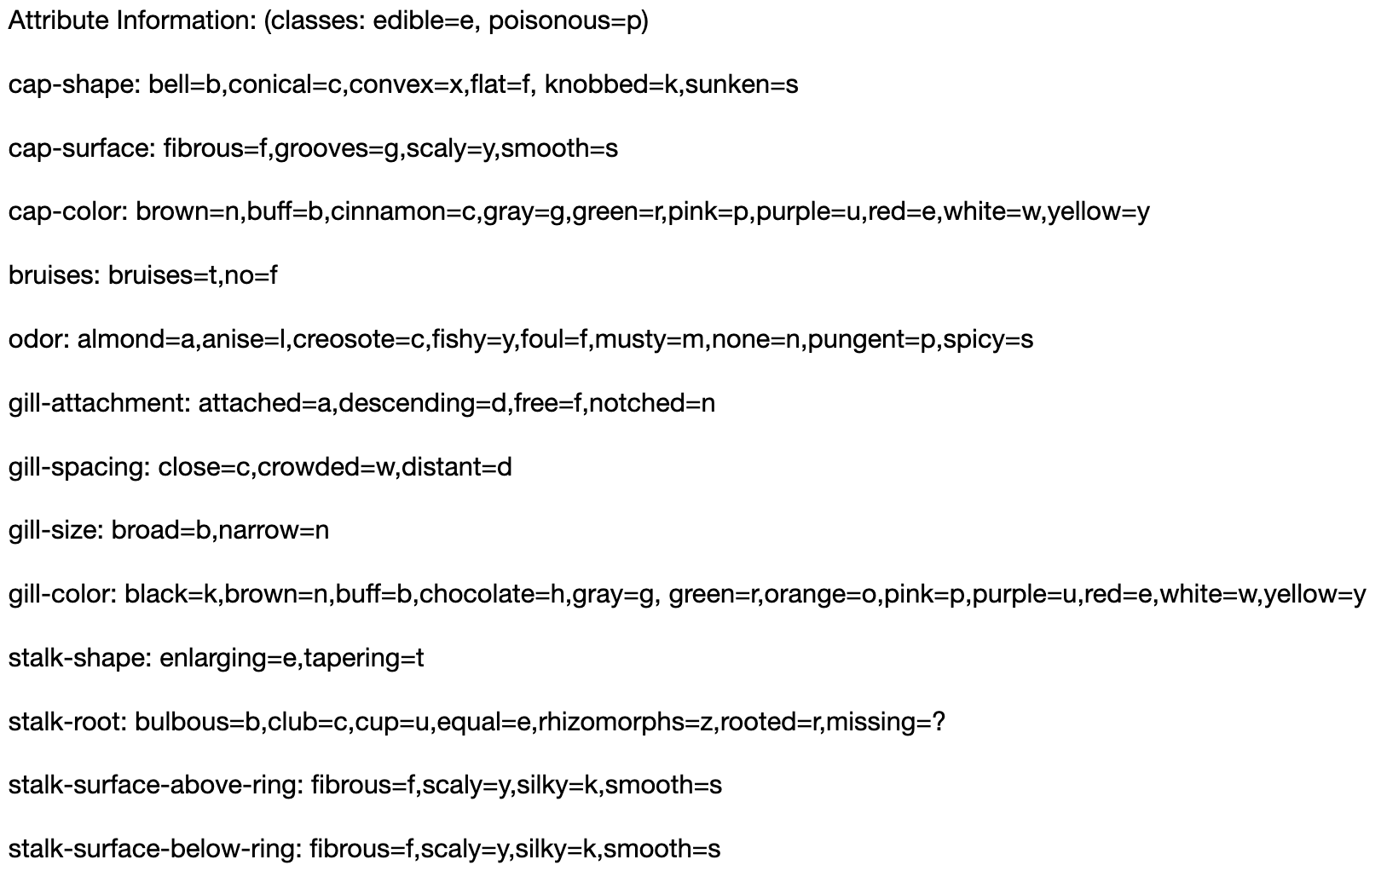
Value Coding Dictionary

Slide 5
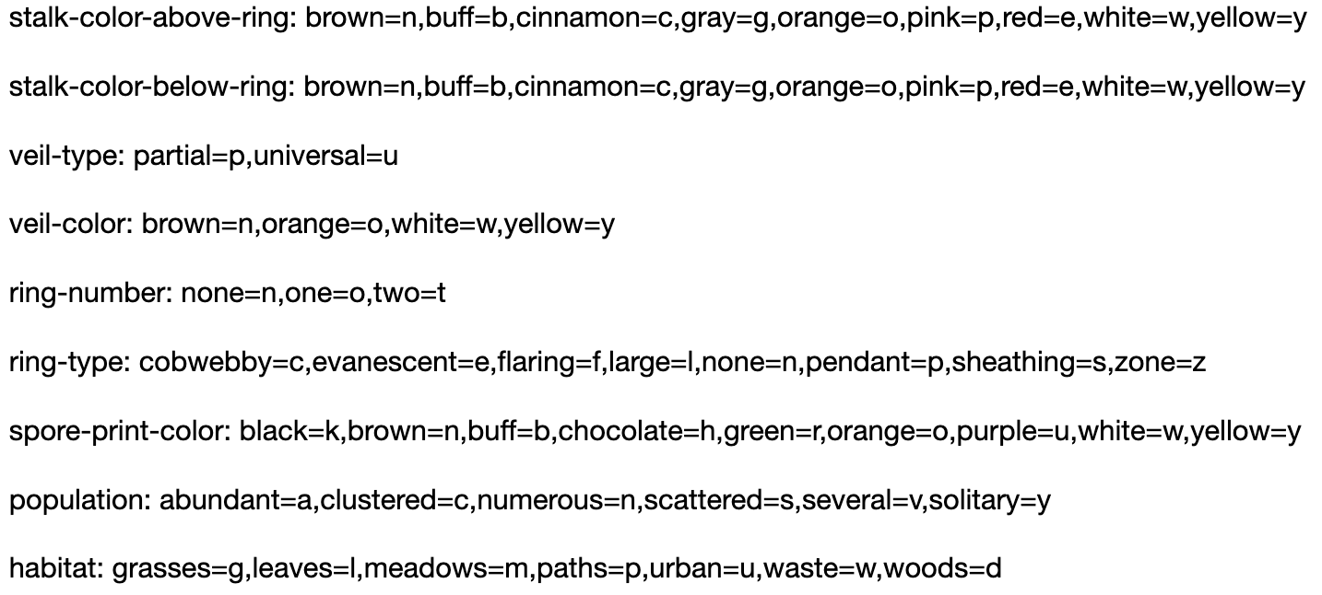

Slide 6
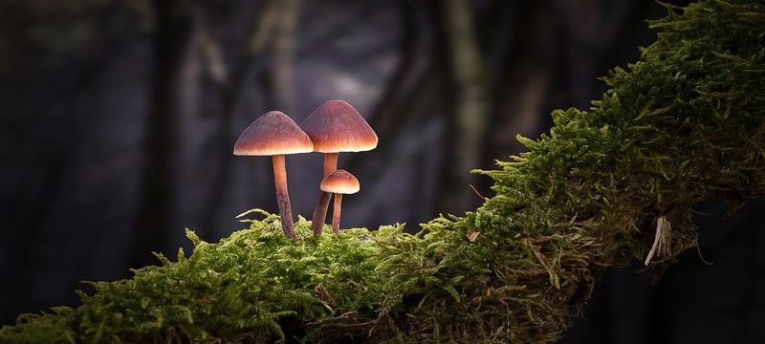
Data Cleaning/Preparation
Dropped “veil-type” column
NaN values defined as “?”
Dummy variables

Slide 7
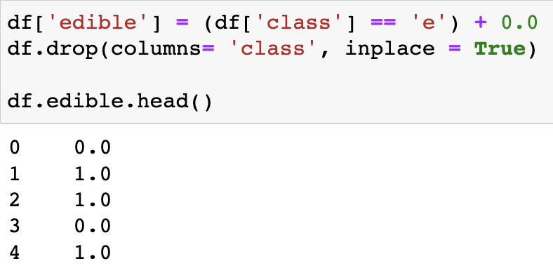
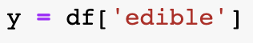
Our target variable: edibility

Slide 8
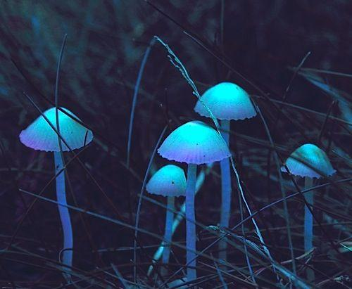
Random Forest Classifier
Used Random Forests
AUC Score: 1.0
Dataset Correlation

Slide 9
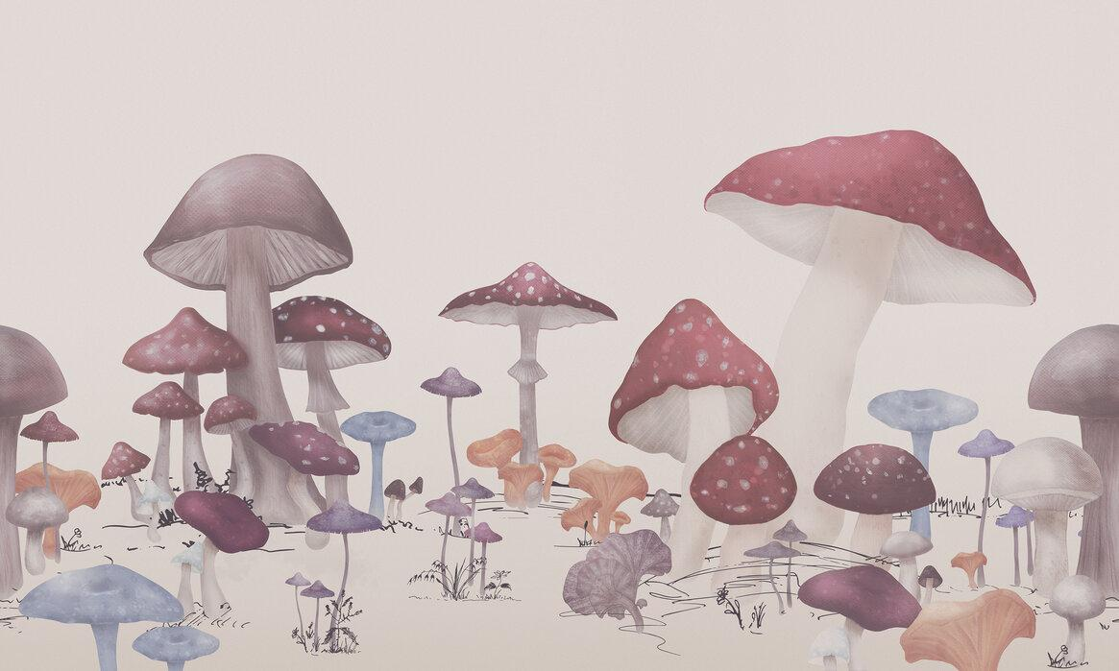
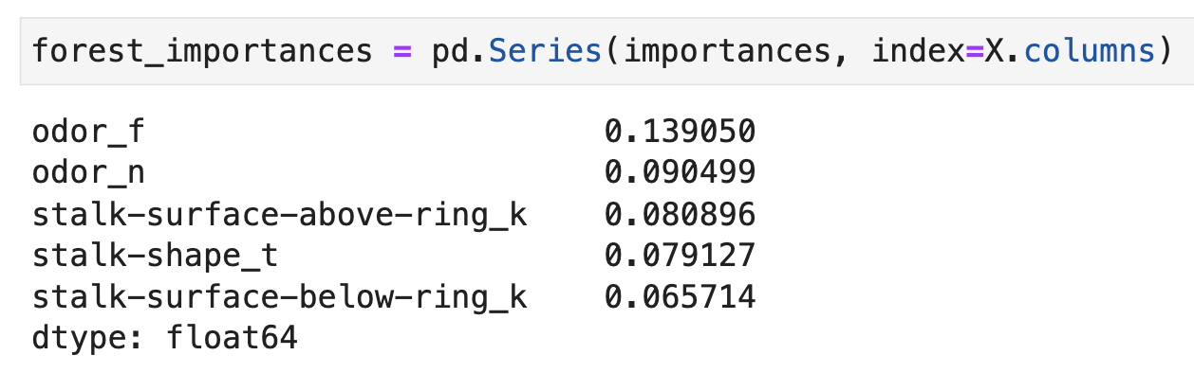

Slide 10
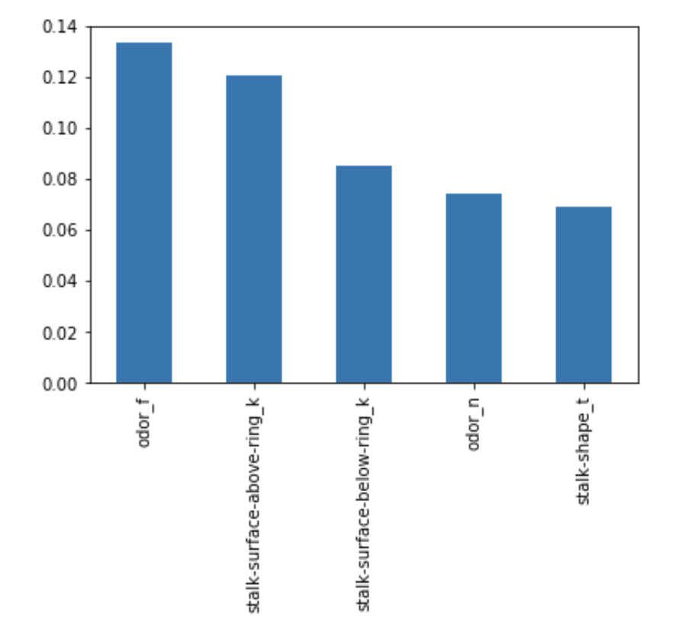

Slide 11
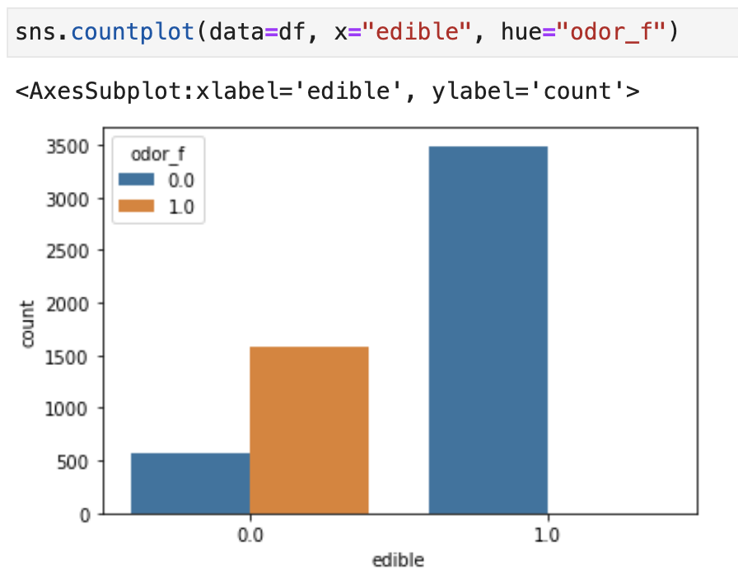

Slide 12
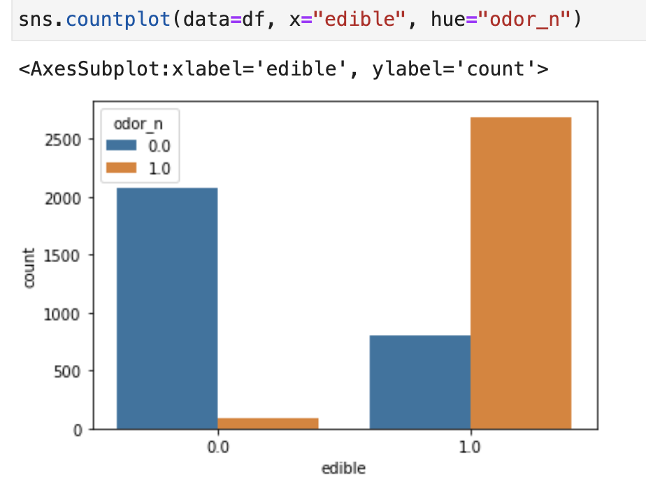

Slide 13
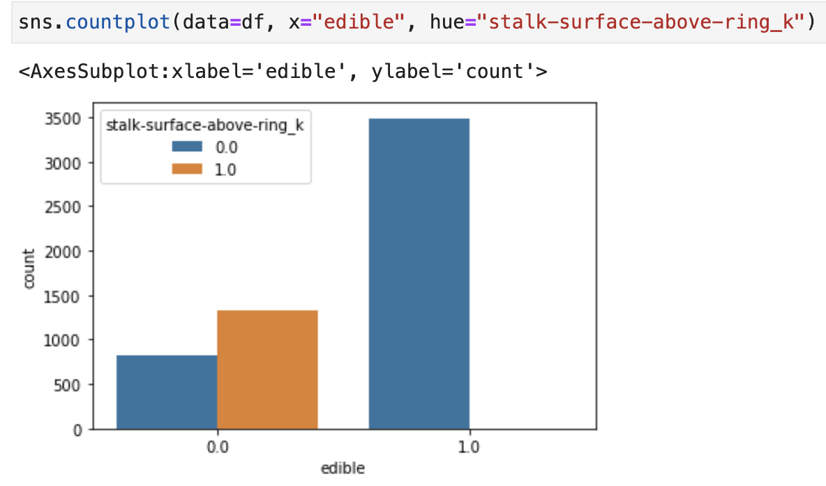

Slide 14
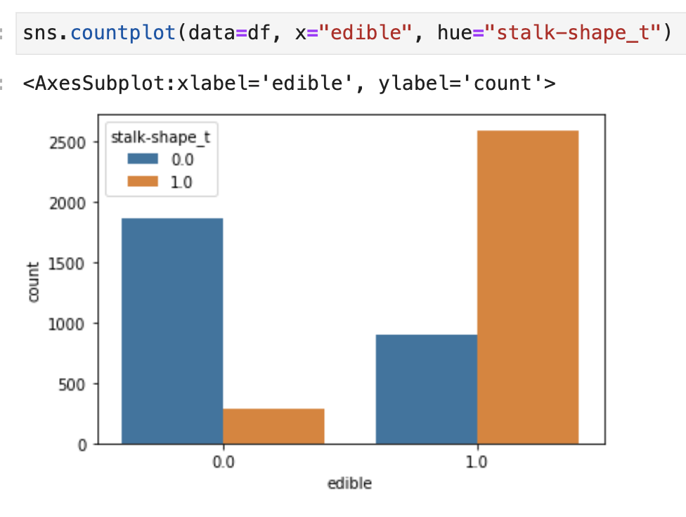

Slide 15
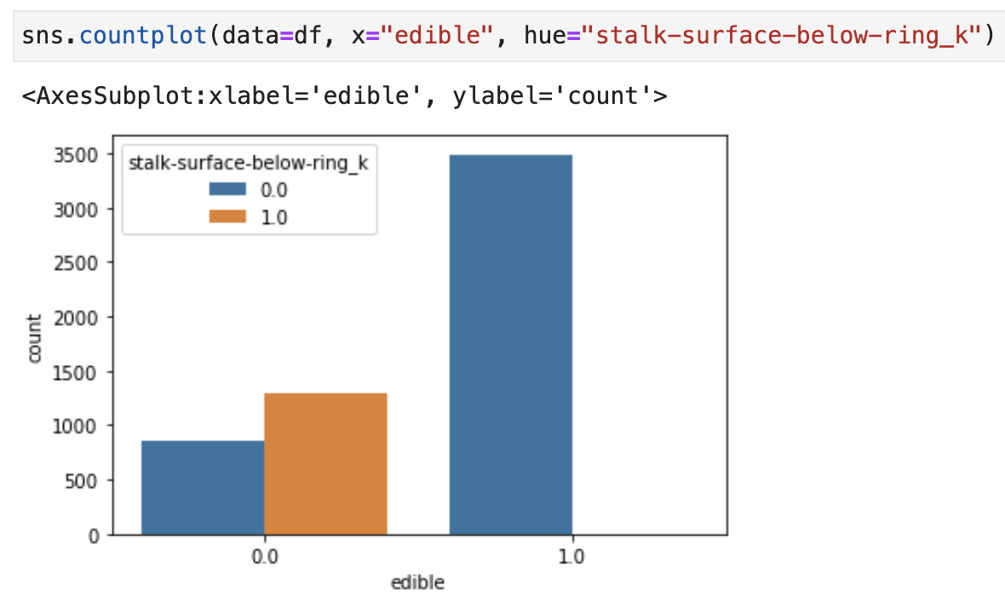

Slide 16
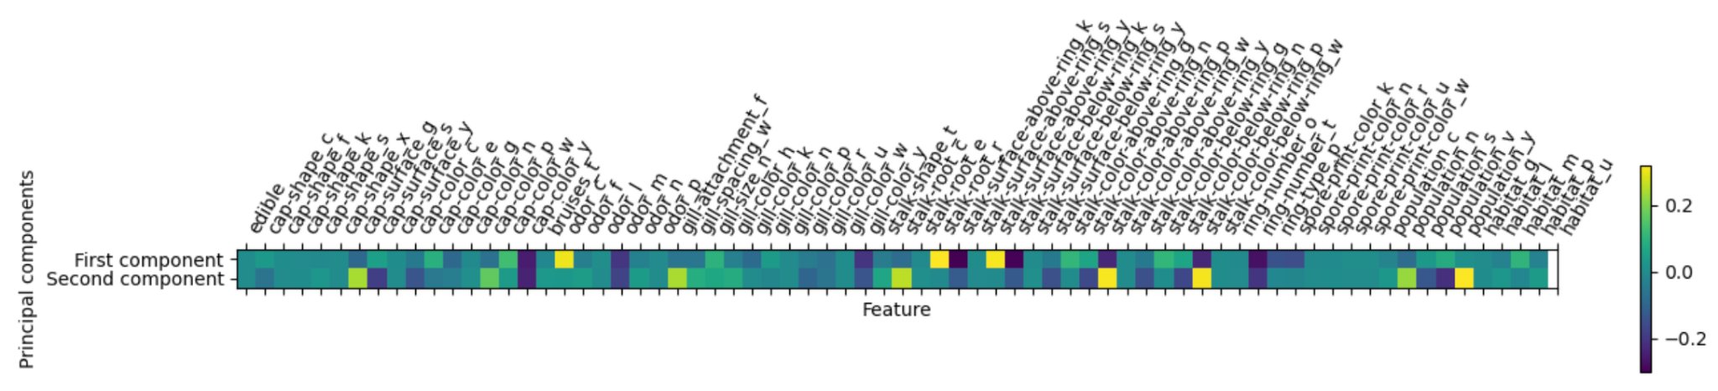
Principal Component Analysis
Notes:
To try and further explain our high supervised model scores, we decided to do PCA to try and make eventually clustering graphs more interpretable in order to try and detect underlying patterns in the data, .
Because we used dummy variables instead of variable encoding, our data has become highly dimensional with 70 features. However, because dummy variables have binary encoding, we did not have to scale our data before modeling.
The first principal component, explains the largest variation in the data (Around 21% of variance), while the second principal component, explains the second largest variation (about 12%). The remaining principal components explain progressively smaller amounts of variation.

Slide 17
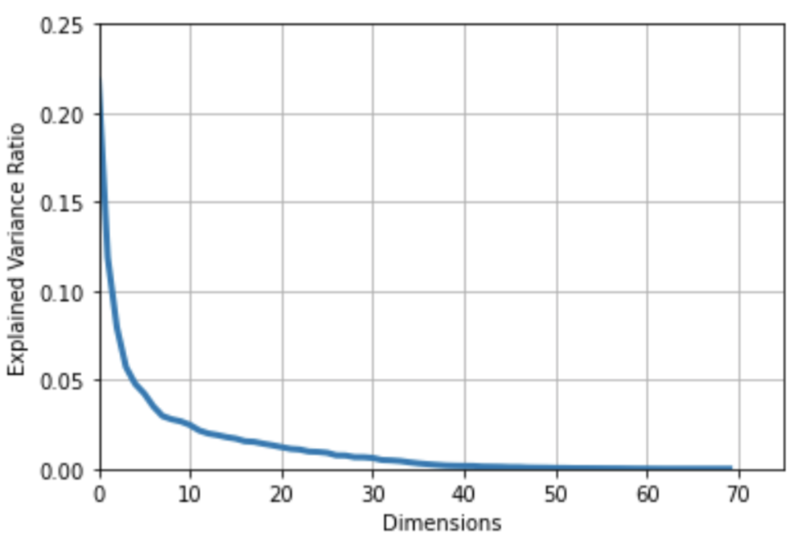
Notes:
This graph shows the how the marginal increase in explained variance by each additional component becomes really small after the 30th component

Slide 18
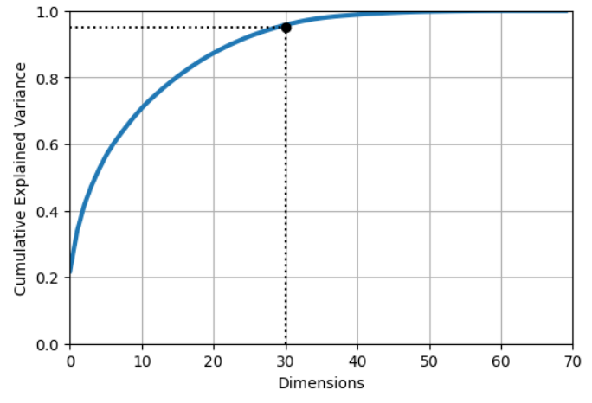
Notes:
PCA: cumulative explained variance.
10 components explain 68% of cumulative variance, 20 components explain 86% of cumulative variance and with 30 components, we can explain over 95% of cumulative variance. By using 2 components, we are enabled us 2 dimensional graphs to visualize and interpret underlying trends in our data through clustering.

Slide 19
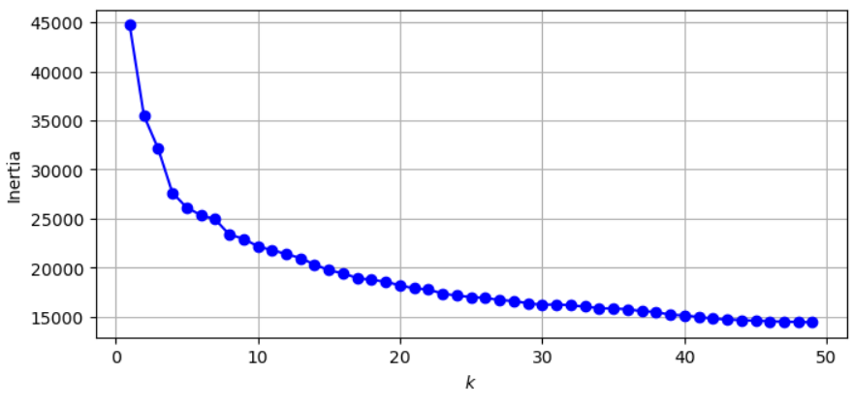
Notes:
Elbow Method: Optimal number of k/clusters is 4 based off the graph and respect to the inertia.
HOWEVER, you’ll see that we chose two instead since it was a lot more interpretable in comparison to 3 or 4 clusters when looking at the scatter plot.
2 clusters makes it easier to understand which parts of the results are edible a

Slide 20
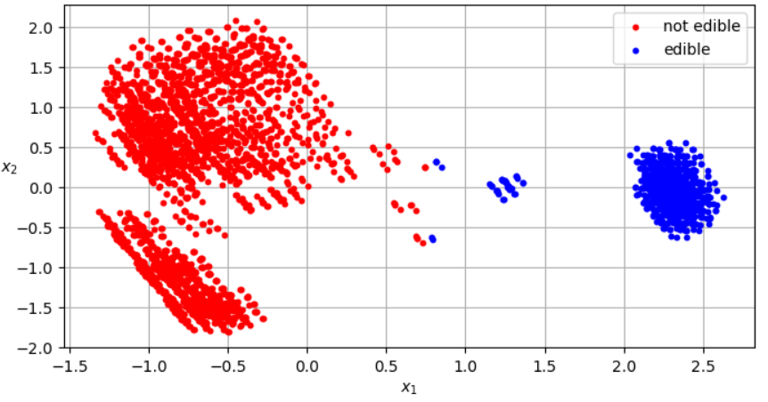
Notes:
Scatter plot: Red is not edible and blue is edible.
Refer to the PCA that Louie explained. First components explains the most and the following gradually explains less.
Hence, x1 is showing something amazing here since whenever x1 is positive, the results come out to show edible mushrooms mainly.
The clump on the very right is significant since it shows how easy it is to predict whether a mushroom is edible or not.
The only gray area is really when x1 is between 0.7-0.8.

Slide 21
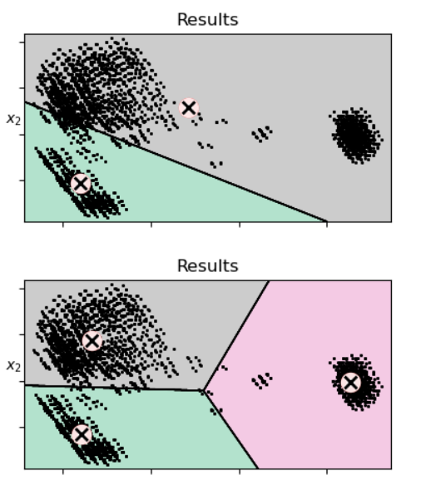
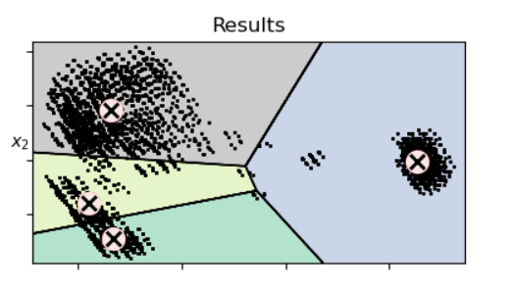
Notes:
Looking at the way clusters are made, three clusters is the most interpretable.
It separates the edibility that was show in the previous slide with a centroid while providing two centroids for the poisonous/unedible mushrooms.

Slide 22

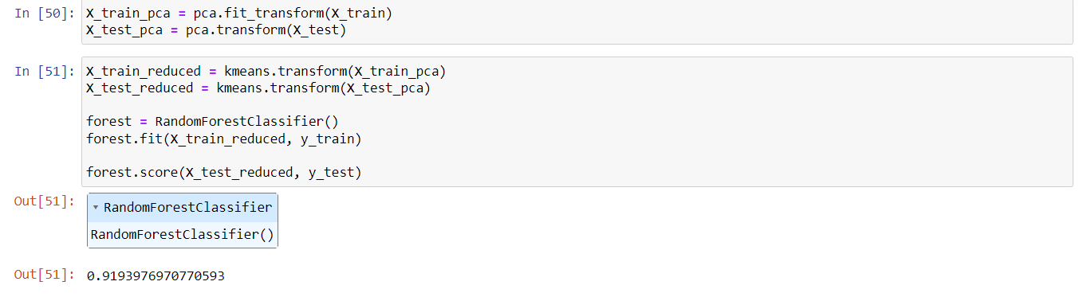
Clustering
Supervised Random Forest:
Score: 1.0000
When using 3 clusters and PCA:
Random Forest Score: 0.9193
Notes:
From supervised to unsupervised we go from 1.0 to 0.90 accuracy. Clustering helped us understand how we got perfect score when doing random forest only since PCA and clustering showed us 91.9% accuracy for 3 clusters when 40% of the variance is explained.

Slide 23
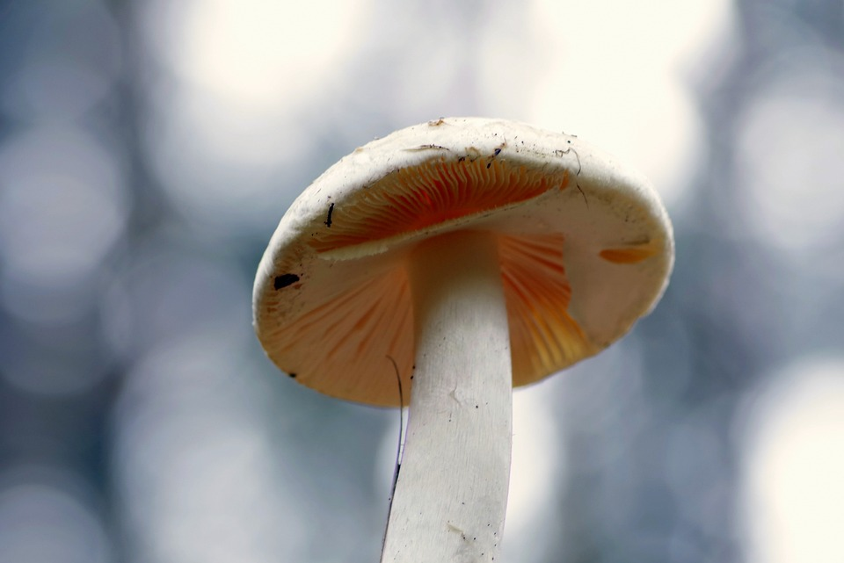
So What?
Safety: toxic or nontoxic mushrooms?
Conservation: overharvesting of mushrooms
Agriculture: demand for high-quality, edible mushrooms
Scientific Research: Biology and ecology of mushrooms
Recreational Purposes: mushroom foraging or psychedelics
Notes:
Safety: There are many different species of mushrooms, and some of them can be toxic or even deadly if consumed. By training a machine learning model to recognize the characteristics of edible mushrooms, we can help people identify which mushrooms are safe to eat and which ones are not.
Conservation: Certain mushroom species are highly valued for their culinary or medicinal properties, and over-harvesting can lead to the depletion of these species. By using machine learning to predict the edibility of mushrooms, we can help conservationists identify which species are most vulnerable and take steps to protect them.
Agriculture: Mushroom farming is a growing industry, and there is a demand for high-quality, edible mushrooms. By using machine learning to classify different mushroom species based on their edibility, we can help farmers optimize their growing conditions and improve the quality of their crops.
Scientific research: Understanding the characteristics that make certain mushrooms edible or toxic can help us learn more about their biology and ecology. By training machine learning models to identify the features that are most important for edibility, we can gain insights into the underlying mechanisms that determine whether a mushroom is safe to eat or not.
Recreational Purpose: Some may have keen interest in foraging wide variety of mushrooms, whether it’s for eating or personal pleasure

Slide 24
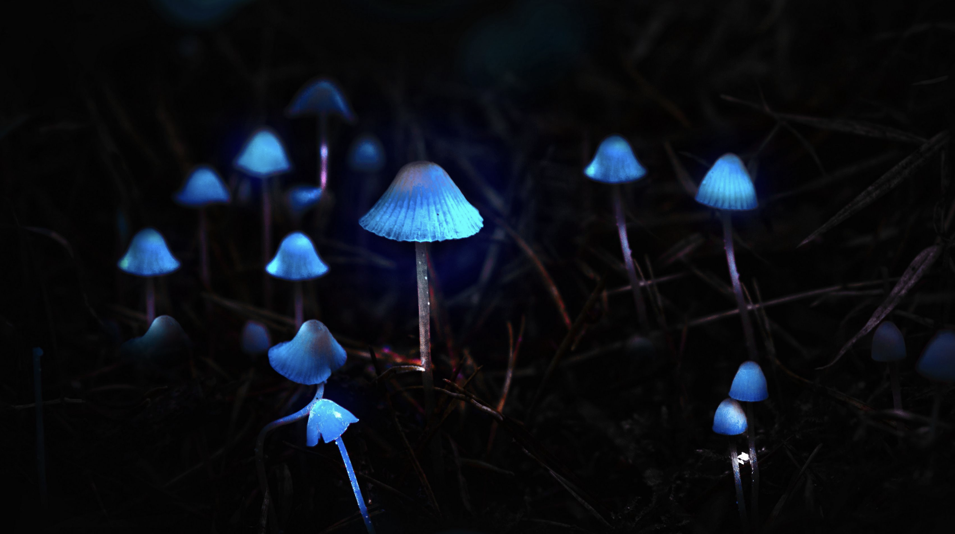
Q&A

